Slide 1

Unlocking the Award Mystery

Slide 2
The Garden Club Structure
The Local Garden Club
Garden Club of South Carolina, Inc. (GCSC)Districts – seven districts, each having a District Director and Assistant District Director
Garden Club of South Carolina, Inc. (GCSC)
South Atlantic Region of Garden Clubs (SAR) – five states – South Carolina, North Carolina, Kentucky, Virginia, and West Virginia
National Garden Clubs, Inc. (NGC)

Slide 3
National Garden Clubs, Inc. By the Numbers for 2023 - 2024
51 State Clubs and 8 regions
5,000 Member Clubs and 24 Youth Clubs
138,976 members and 10,778 Honorary Life Members
195 International Affiliates
There were 385 recipients of the Plant America grants totaling over $390,000
Over $5,366,000 in scholarships were given to 1,590 recipients
It is a 501c3 and one of the largest volunteer organizations in the United States and is headquartered in St. Louis, MO

Slide 4


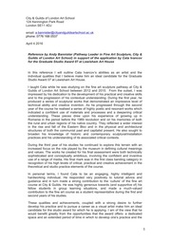
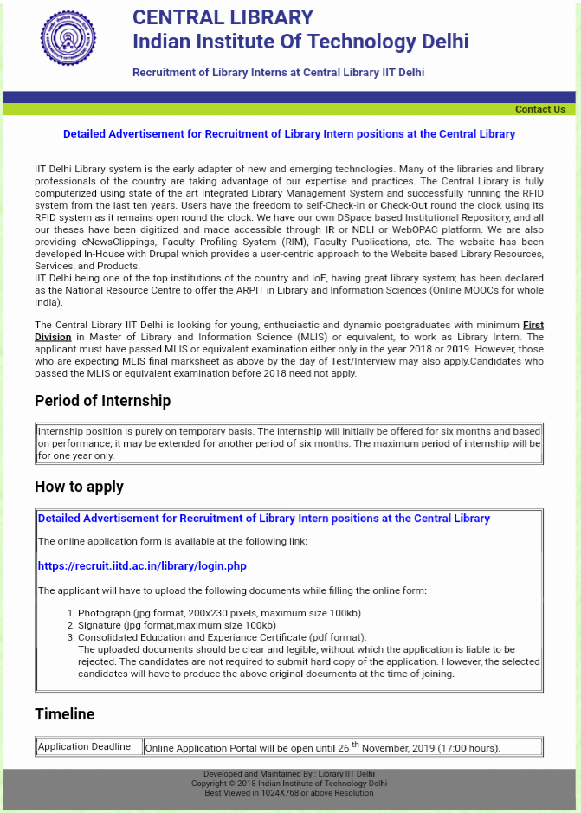


The Award Maze
District Level
GCSC President 9/1
DD 9/1 and District Award to DD 1/15
First Place Yrbks sent to GCSC 10/1 and District Award Winners announced at Dist. Mtg.
WE WON!!
GCSC – State Level
Awards presented at State Mtg or State Conv.
WE WON!!
District First Place yearbooks evaluated and First Place in State sent to SAR
Awards are evaluated and First Place Awards that meet the criteria are sent to both SAR and NGC by January 25
Awards are created & presented at State Mtg or State Conv.
WE WON!!
State Award Application due Dec 10
South Atlantic Region of Garden Clubs
WE WON!!
WE WON!!

Slide 5
How are yearbooks and State Awards Evaluated ????
Yearbooks are grouped by membership size – Under 20, 20-29-, 30-44, 45-69, 70-99, 100-299, 300+ and also the Council Yearbooks. The books are evaluated using the Club Yearbook Scale of Points, included in the Award List located on the GCSC website. The first place award winners are forwarded onto the South Atlantic Region of Garden Clubs for award consideration.

Slide 6
Yearbook Focus Areas
Programs – 50 pts., especially variety of program topics, variety of styles (lectures, tours, PPT), and a variety of speakers.
Projects – 35 points, provide a list of continuing and new projects along with giving a brief descript of projects (include location, name of chairman, how members participate, list of donations, plans for maintenance if applicable.
The total is 85 points out of 100.

Slide 7
State Award Evaluation
Awards are grouped by membership size – small 1-20, medium 21-50, large 51-99, and extra large 100. The awards are evaluated using a Scale of Points, included in the Award List located on the GCSC website. The first place award winners are forwarded onto the South Atlantic Region of Garden Clubs and the National Garden Clubs, Inc. for award consideration.

Slide 8
Award Scale of Points
Presentation: Neat, concise, includes all required information on the Application Form
(3 sheets allowed) or the Book of Evidence, if required. 5 pts.
Achievement: Scope of project, need and fulfillment, benefits, accomplishment,
comprehensiveness of work, activities to attain goals, evaluation of goals reached,
educational, prior planning, very brief history if continuing project, financial report, other. 65 pts
Participation: Size of club; involvement of members, community, government agencies,
professionals, youth, residents in facilities, others. Not all of these need to be involved. 15 pts.
Record or Documentation: Supporting data (as applicable), clear, well-labeled and neatly attached, before and after photographs if applicable, landscape plan (does not have to be professionally drawn), financial report, letters of appreciation, community awards, newspaper/magazine articles (if possible), radio or TV script (if possible), etc. Photocopies are permitted. 15 pts.
Total 100 pts.

Slide 9
Happy Writing
Are you aware of the four new state awards under President’s Initiatives?
Any Questions???

